Slide 1

Computer Architecture
Part I
Boolean Algebra and Map Simplifications
Department of Computer Science, Faculty of Science, Chiang Mai University

Slide 2
Outline
Logic Gates
Boolean Algebra
Map Simplification

Slide 3
Boolean Function
A Boolean function can be expressed algebraically with binary variables,
the logic operation symbols, parentheses,
and equal sign.
To represent a function in a truth table
we need a list of the 2^{n} combinations of
the n binary variables.

Slide 4
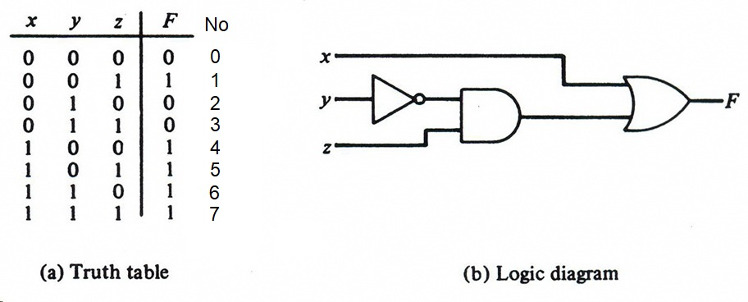
Truth Table and Logic Diagram for
F = x + y′z
Sum of Minterm
F(x, y, z) = Σ(1, 4, 5, 6, 7)

Slide 5
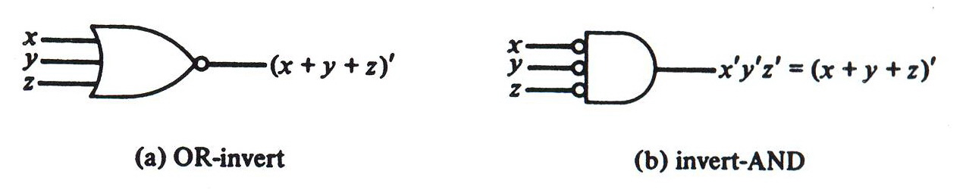
Two Graphic Symbols for NOR gate
DeMorgan’s theorem

Slide 6
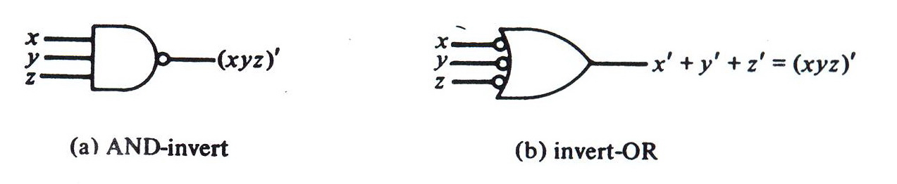
Two Graphic Symbols for NAND gate
DeMorgan’s theorem

Slide 7
Boolean Algebra Manipulation
F = ABC + ABC’ + A’C
= AB (C + C’) + A’C
= AB (1) + A’C
= AB + A’C
By manipulating a Boolean expression according to Boolean algebra rules, one may obtain
a simpler expression that will require fewer gates.

Slide 8
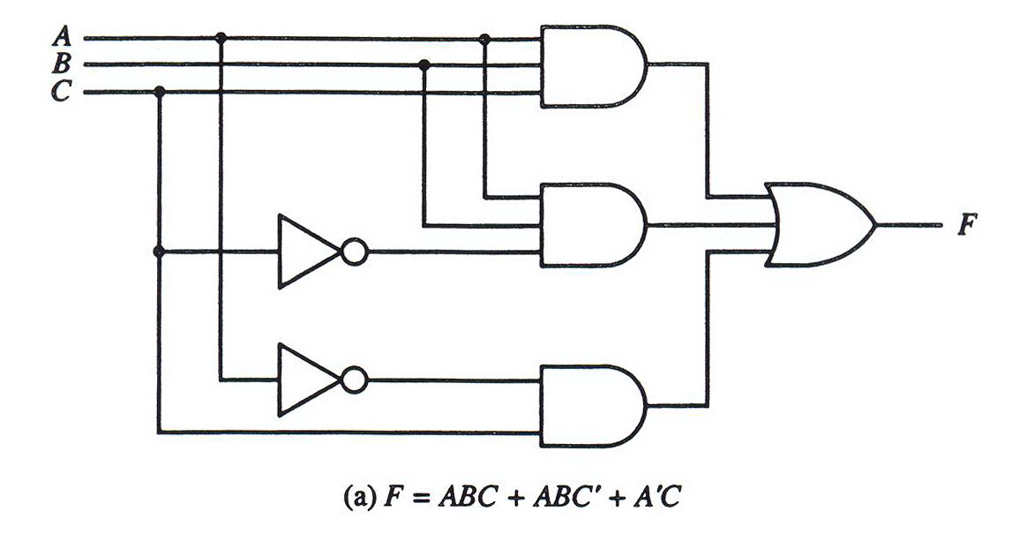
Two Logic Diagrams for the Same Boolean Function

Slide 9
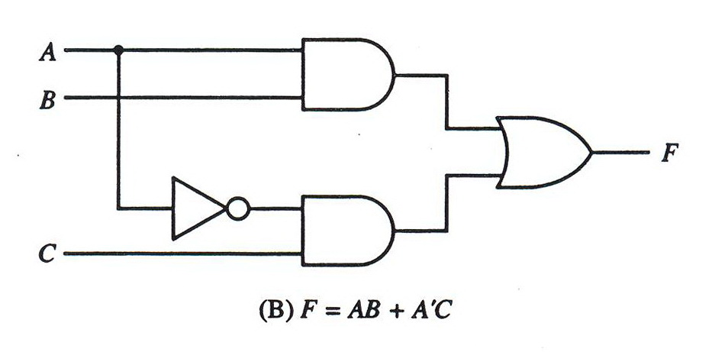
Two Logic Diagrams for the Same Boolean Function

Slide 10
K-Map (Karnaugh Map)
The squares corresponding to minterms that produce 1 for the function are marked by a 1 and the others are marked by a 0 or are left empty.
The squares containing 1’s are combined in groups of adjacent squares.
These groups must contain a number of squares that is an integral power of 2.

Slide 11
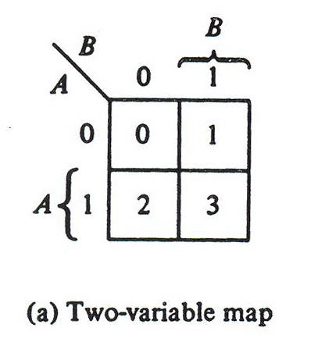
Maps for Two-Variable Functions
B′
A′

Slide 12
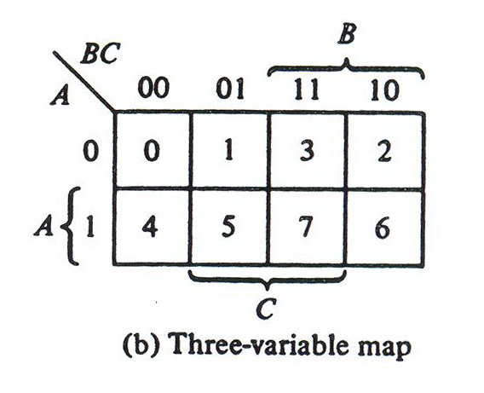
Maps for Three-Variable Functions
B′
A′
C′
C′

Slide 13
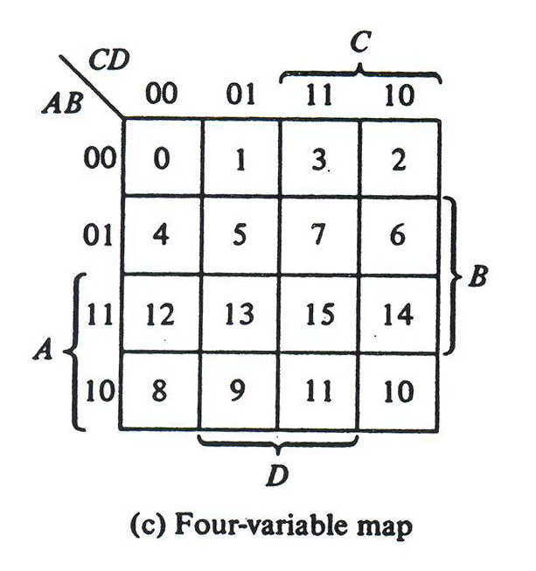
Maps for Four-Variable Functions

Slide 14
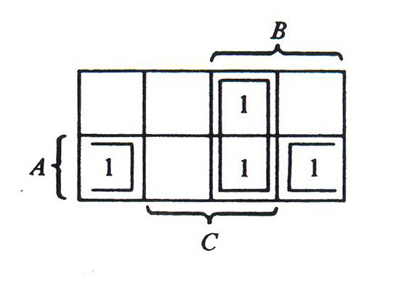
Map for F(A, B, C) = ∑(3, 4, 6, 7)
two squares are adjacent if they share an edge.
The squares at the extreme ends of the same horizontal row are also to be considered adjacent.
F = BC + AC′
The OR of all terms gives the simplified algebraic expression.

Slide 15
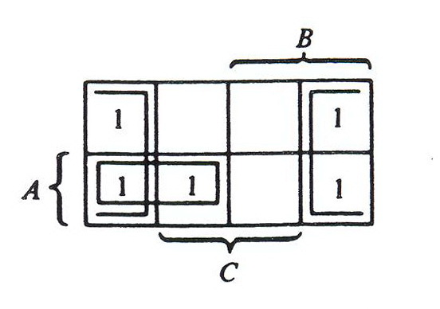
Map for F(A, B, C) = ∑(0, 2, 4, 5, 6)
Groups of combined adjacent squares may share one or more squares with one or more groups.
F = C′ + AB′

Slide 16
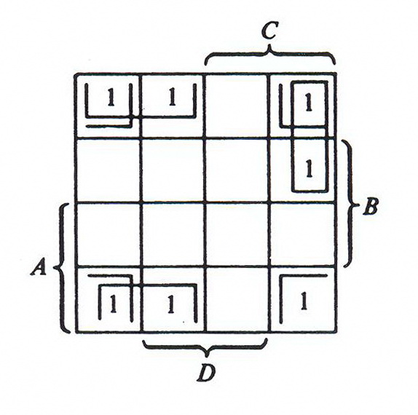
Map for F(A, B, C, D) = ∑(0, 1, 2, 6, 8, 9, 10)
The squares at the top and the bottom of a column are adjacent.
The four corner squares of a map must also be considered to be adjacent.
Sum-of-Products
F = B′D′ + B′C′ + A′CD′

Slide 17
Product-of-Sums Simplification
If we mark the empty squares with 0’s and combine them into groups of adjacent squares, we obtain the complement of the function (F’).
Taking the complement of F’ produces an expression for F in product-of-sums form.

Slide 18
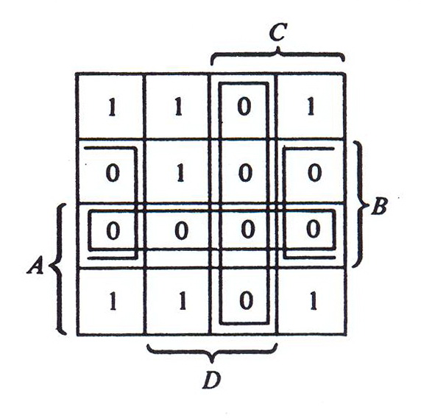
Map for F(A, B, C) = ∑(0, 1, 2, 5, 8, 9, 10)
Product-of-Sums
F′ = AB + CD + BD′
F = (A′ + B′)(C′ + D′)(B′ + D)

Slide 19
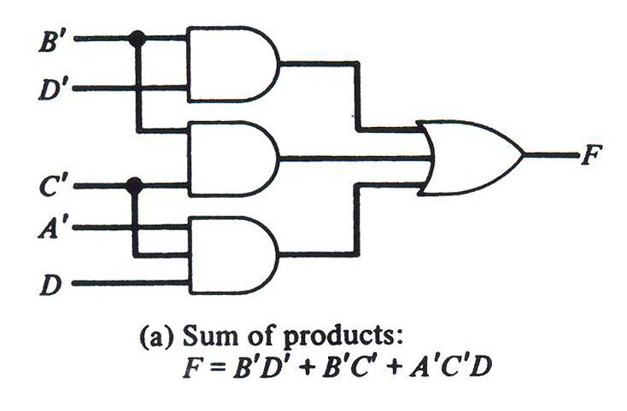
Logic Diagrams with 3 ANDs and 1 OR Gates

Slide 20
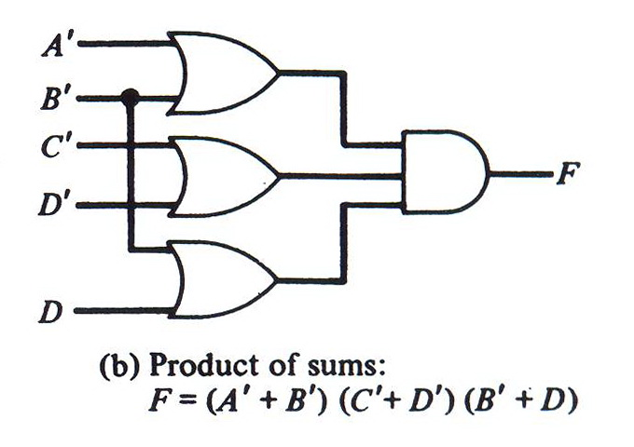
Logic Diagrams with 3 ORs and 1 AND Gates

Slide 21
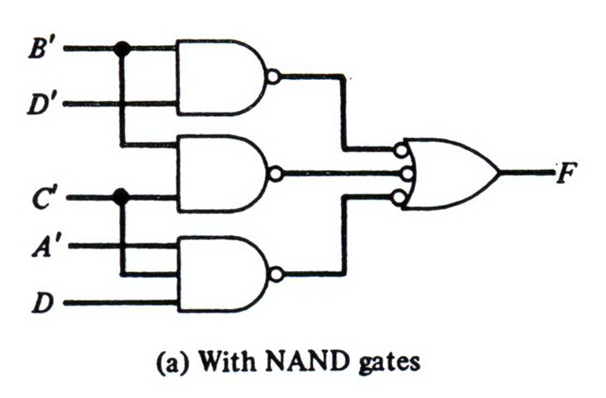
Logic Diagrams with 4 NANDs

Slide 22
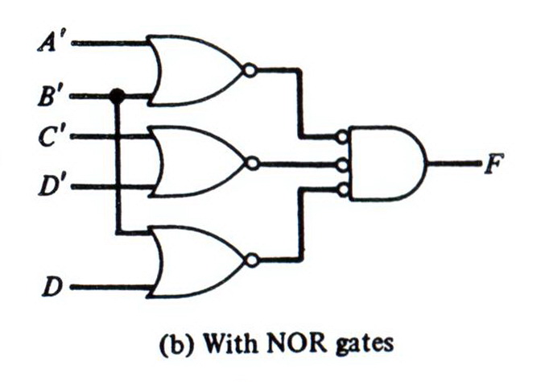
Logic Diagrams with 4 NORs

Slide 23
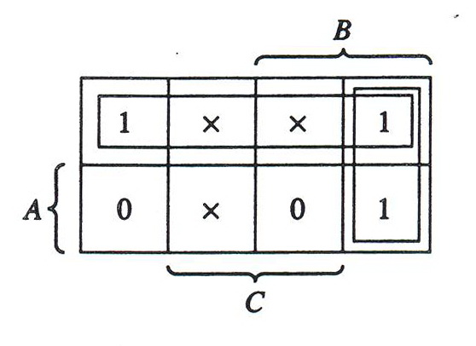
Don’t-Care Conditions
F(A, B, C) = ∑(0, 2, 6) d(A, B, C) = ∑(1, 3, 5)
The don’t care condition may be assumed to be either 0 or 1.
F = A′ + BC′
F(A, B, C) = ∑(0, 1, 2, 3, 6)

Slide 24
Reference
M. Moris Mano, Computer System Architecture, 3rd ed. NJ: Prentice Hall, 1992.

